Slide 1
Facturation
& Paiements
Handoff technique — pipeline end-to-end + modules OPS
80
115 K
1,6 M
15
Scripts migration
Factures importées
Items (incl. backfill)
Pages OPS
Avril 2026 • erp.gigafibre.ca + client.gigafibre.ca + ops

Slide 2
Flux facture → paiement
Scripts & fichiers utilisés à chaque étape
1. Import legacy
2. Facture
3. Rendu PDF
4. QR / Magic-link
5. Landing publique
6. Stripe + Payment Entry
→
→
→
→
→
MariaDB → PostgreSQL
ERPNext Sales Invoice
Chromium --print-to-pdf
Tokens HMAC-SHA256
client.gigafibre.ca/pay-public
Checkout → webhook → réconciliation
• import_invoices.py
• import_payments.py
• import_payment_methods.py
• import_payment_arrangements.py
• import_expro_payments.py
• backfill_service_location.py
• fix_invoice_outstanding.py
• fix_invoice_customer_names.py
• add_missing_custom_fields.py
• setup_invoice_print_format.py
• test_jinja_render.py
• Print Format: « Facture TARGO »
• Jinja template (inline)
• pdf_generator="chrome"
• Doctype: Sales Invoice
• Custom field: service_location
• gigafibre_utils.api.invoice_pdf
• Dockerfile (chromium install)
• common_site_config:
• chromium_path=/usr/bin/chromium
• cairosvg → logo PNG
• Producer: Skia/PDF m147
• ~1 s / facture
• api.invoice_qr(invoice)
• api.invoice_qr_datauri(invoice)
• api._sign_pay_token
• api.validate_pay_token
• api.request_magic_link
• api.pay_token (admin)
• api.pay_redirect (portal)
• Secret: gigafibre_pay_secret
• gigafibre_utils/www/
• pay-public.html
• /opt/traefik/dynamic/
• pay-public.yml
• Traefik priority ≥ 250
• (carve-out Authentik)
• Vanilla JS, pas de build
• api.create_checkout_session
• api.stripe_webhook
• api._stripe_post
• api._stripe_verify_signature
• Secret: gigafibre_stripe_secret_key
• Secret: gigafibre_stripe_webhook_secret
• Twilio: twilio_account_sid / token / from
Configuration (common_site_config.json)
gigafibre_pay_secret · gigafibre_pay_host · gigafibre_stripe_secret_key · gigafibre_stripe_webhook_secret · twilio_account_sid · twilio_auth_token · twilio_from_number · chromium_path

Slide 3
Modules OPS
Pages & composants · apps/ops/src/
Clients
Dispatch
Facturation
• pages/ClientsPage.vue
• pages/ClientDetailPage.vue
• components/customer/*
• components/shared/
• detail-sections/
• InvoiceDetail.vue
• PaymentDetail.vue
• SubscriptionDetail.vue
• EquipmentDetail.vue
• IssueDetail.vue
• pages/DispatchPage.vue
• components/dispatch/
• pages/dispatch-styles.scss
• mode sombre (exception)
• shared/CreateInvoiceModal.vue
• shared/detail-sections/
• InvoiceDetail.vue
• onglet Aperçu client
• iframe → invoice_pdf
• shared/detail-sections/
• PaymentDetail.vue
Rapports
Network
Équipe & Tickets
• pages/RapportsPage.vue
• pages/ReportARPage.vue
• pages/ReportRevenuPage.vue
• pages/ReportTaxesPage.vue
• pages/ReportVentesPage.vue
• pages/NetworkPage.vue
• pages/TelephonyPage.vue
• pages/OcrPage.vue
• pages/EquipePage.vue
• pages/TicketsPage.vue
• pages/AgentFlowsPage.vue
• pages/DashboardPage.vue
• pages/SettingsPage.vue
Déploiement: scp dist/spa/* → /opt/ops-app/ · nginx proxy API (token) · Authentik SSO · Traefik routing

Slide 4
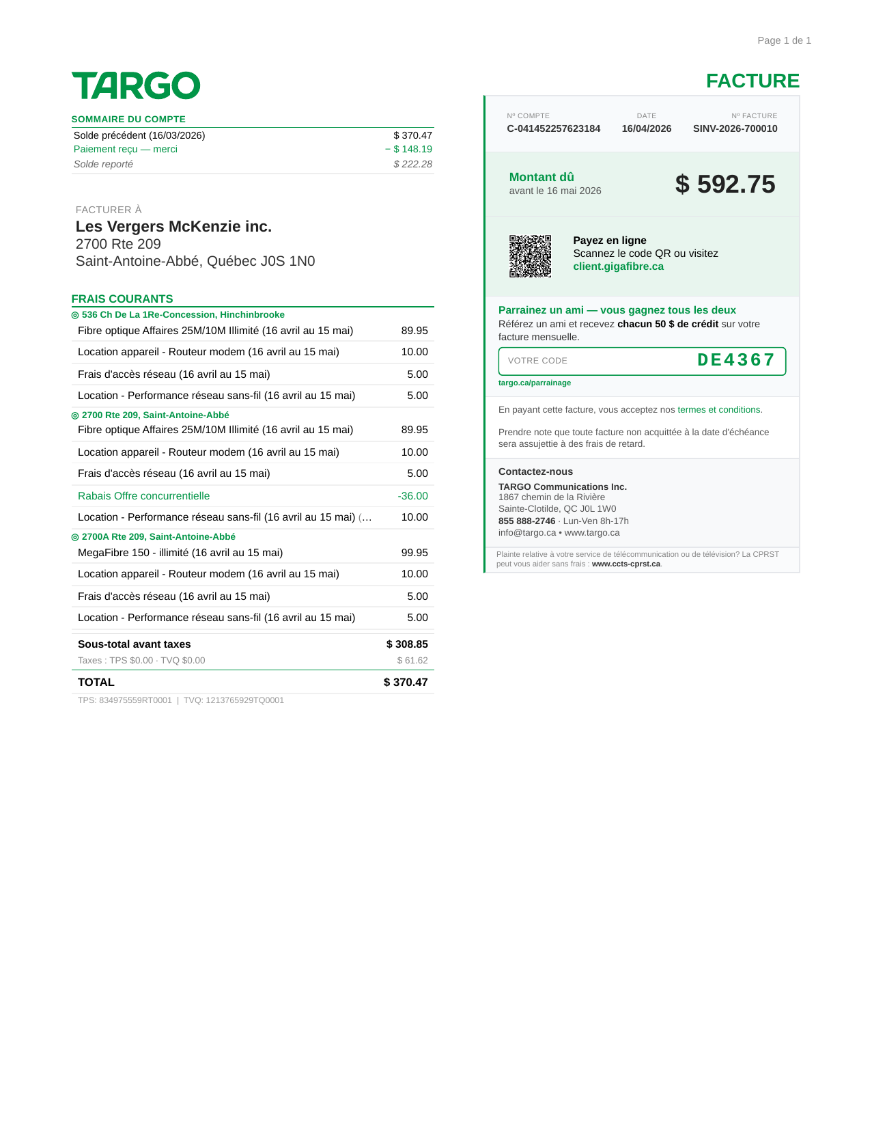
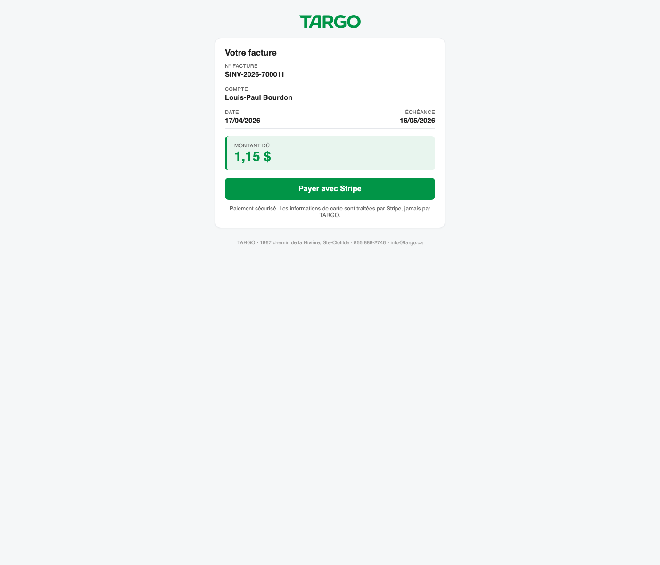
Visuels
PDF Facture TARGO (Chrome) + Landing /pay-public
PDF Facture TARGO
Landing /pay-public
Chromium --print-to-pdf · 1 page · ~1 s
Bypass Authentik · Stripe Checkout · Magic-link SMS/email

